Slide 1
Chapter 12

Slide 2
Objectives

Slide 3
Objectives (cont.)

Slide 4
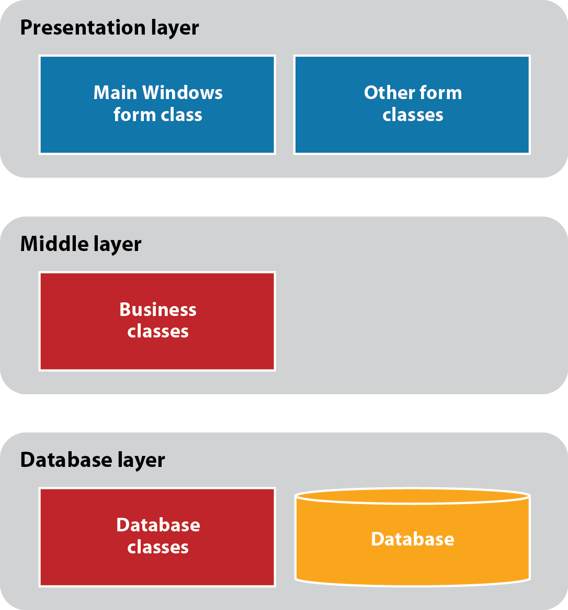
The architecture of a three-layered application

Slide 5
The members of a Product class

Slide 6
The members of a Product class (cont.)

Slide 7
Types of class members

Slide 8
Types of class members (cont.)

Slide 9
Class and object concepts

Slide 10
The Product class: Fields and constructors

Slide 11
The Product class: The Code property

Slide 12
The Product class: The Description property

Slide 13
The Product class: The Price property

Slide 14
The Product class: The GetDisplayText method

Slide 15
Two Product objects that have been instantiated from the Product class

Slide 16
Code that creates these two object instances

Slide 17
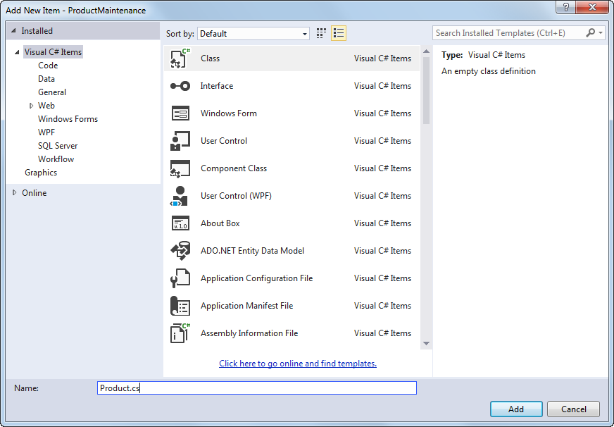
The dialog box for adding a class

Slide 18
The starting code for the new class

Slide 19
Examples of field declarations

Slide 20
A Product class that uses public fields

Slide 21
The syntax for coding a public property

Slide 22
A statement that sets a property value

Slide 23
The syntax for coding a public method

Slide 24
Statements that call the GetDisplayText method

Slide 25
A constructor with no parameters

Slide 26
A constructor with one parameter

Slide 27
Default values for instance variables

Slide 28
A class that contains static members

Slide 29
A class that contains static members (cont.)

Slide 30
Code that uses static members

Slide 31
The Product Maintenance form

Slide 32
The Tag property settings for the text boxes on the New Product form

Slide 33
The Product class

Slide 34
The Product class (cont.)

Slide 35
The ProductDB class

Slide 36
The Validator class

Slide 37
The code for the Product Maintenance form

Slide 38
The code for the Product Maintenance form (cont.)

Slide 39
The code for the Product Maintenance form (cont.)

Slide 40
The code for the New Product form

Slide 41
The code for the New Product form (cont.)

Slide 42
The code for the Validator class

Slide 43
The code for the Validator class (cont.)

Slide 44
The code for the Validator class (cont.)

Slide 45
The syntax for coding an auto-implemented property

Slide 46
A statement that sets the value of an auto-implemented property

Slide 47
A read-only property

Slide 48
A method that returns the value of an expression

Slide 49
A method that executes a single statement

Slide 50
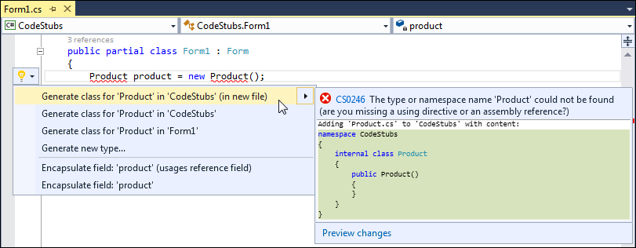
Using live code analysis to generate a class

Slide 51
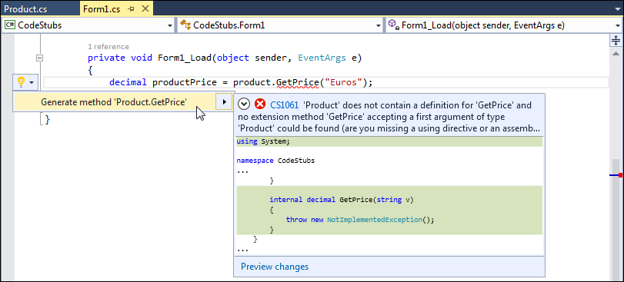
Using live code analysis to generate a method stub

Slide 52
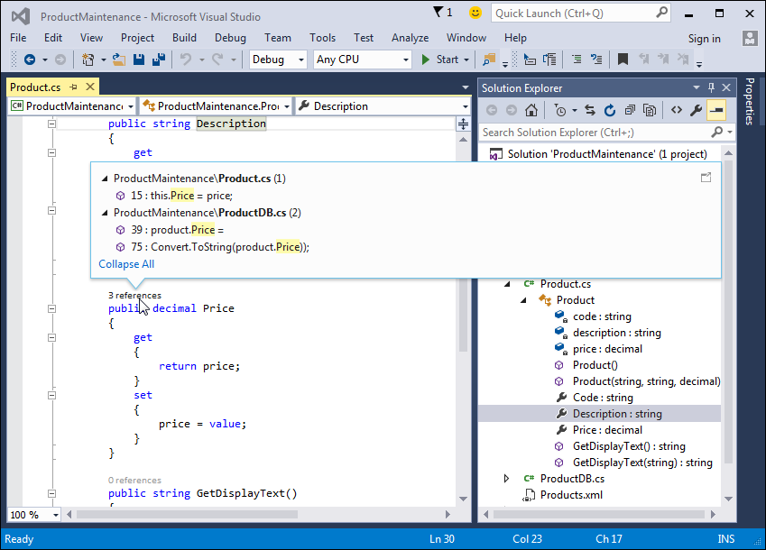
The Product class in the Solution Explorer with references to the Price property displayed*

Slide 53
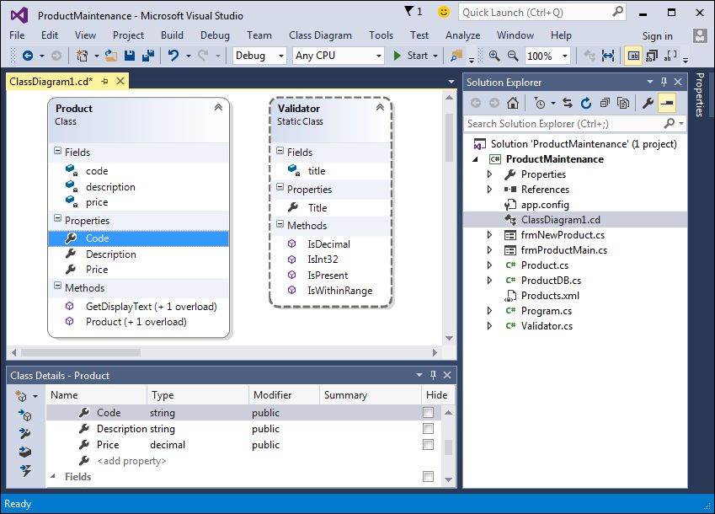
A class diagram that shows two of the classes

Slide 54
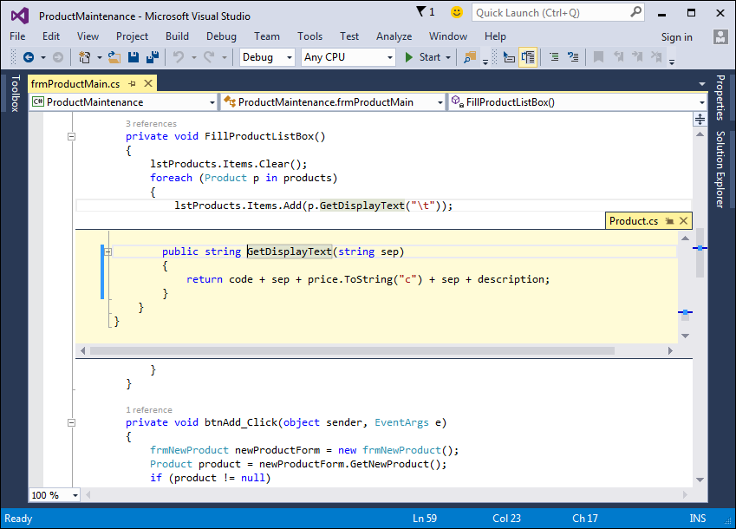
A Peek Definition window with the code for the GetDisplayText method

Slide 55
The syntax for creating a structure

Slide 56
A Product structure

Slide 57
A Product structure (cont.)

Slide 58
Code that declares a variable as a structure type and assigns values to it

Slide 59
Code that uses the default constructor to initialize the instance variables

Slide 60
Extra 12-1 Create and use an Inventory Item class

Slide 61
Project 3-1 Create a basic calculator

Slide 62
Project 3-2 Assign tickets with time slots

Slide 63
Project 3-2 Assign tickets with time slots (cont.)

